Slide 1
Math 9 Section 2.1 What are Exponents
© Copyright all rights reserved to Homework depot: www.BCMath.ca

Slide 2

Problem: Bill Gates decided to Give you money. The first day he will give you one cent and then double the amount each day. How much money will you receive on the 15th day?
The value on the 15th day can also be found by multiplying “2” over 14 times
© Copyright all rights reserved to Homework depot: www.BCMath.ca

Slide 3
What are Exponents?
Exponents are used to represent the multiplication of a constant over many times
Rather than writing out the same constant over again, we can exponents to simplify the expression
The number at the top is the Exponent
Write as a single exponent
The entire expression is a “Power”
ie: 2 to the power of 14
The number in the bottom is the Base
The base is the number that is being multiplied by
The exponent is how many times you multiply the base by itself
© Copyright all rights reserved to Homework depot: www.BCMath.ca

Slide 4
Ex: Write the following as a Power and then evaluate the power
© Copyright all rights reserved to Homework depot: www.BCMath.ca

Slide 5
Powers with Negative bases
If the base has a negative sign within brackets, then the base is negative
If the negative sign is not within brackets or there are no brackets, then the base is positive, with a negative sign in front
The product of two negative bases will become positive
Base is -5
Base is 5, so only the “5” is squared and not the negative sign
© Copyright all rights reserved to Homework depot: www.BCMath.ca

Slide 6
Ex: Evaluate each of the powers
© Copyright all rights reserved to Homework depot: www.BCMath.ca

Slide 7
Ex: Indicate whether if the expression is positive or negative
Positive
Negative
Positive
Positive
Positive
© Copyright all rights reserved to Homework depot: www.BCMath.ca

Slide 8
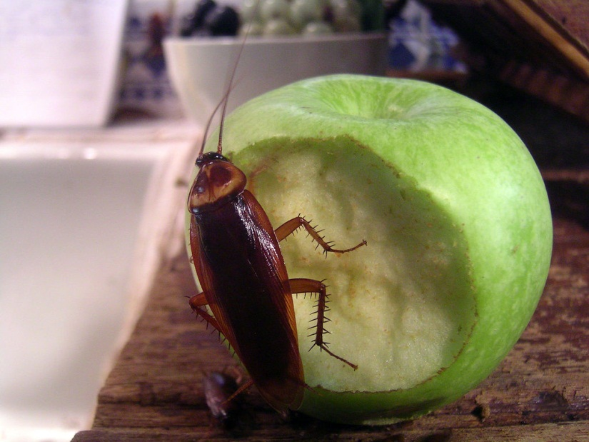
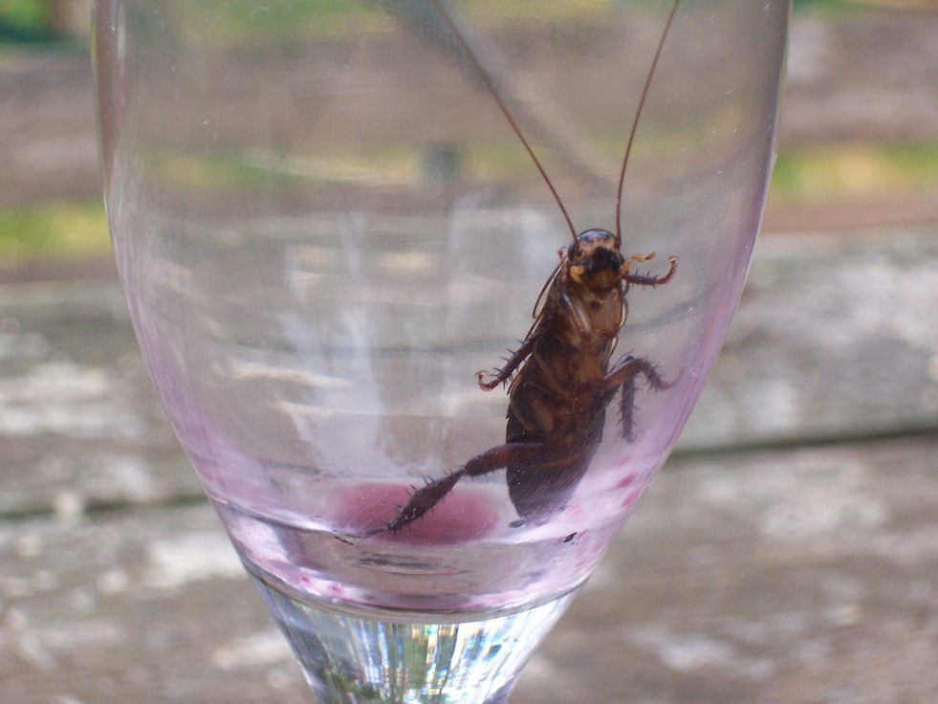
Ex: Cockroach Question:
If a colony of 2 cockroaches doubles every day, how many cockroaches will there be after 1 week?
© Copyright all rights reserved to Homework depot: www.BCMath.ca
© Copyright all rights reserved to Homework depot: www.BCMath.ca

Slide 10
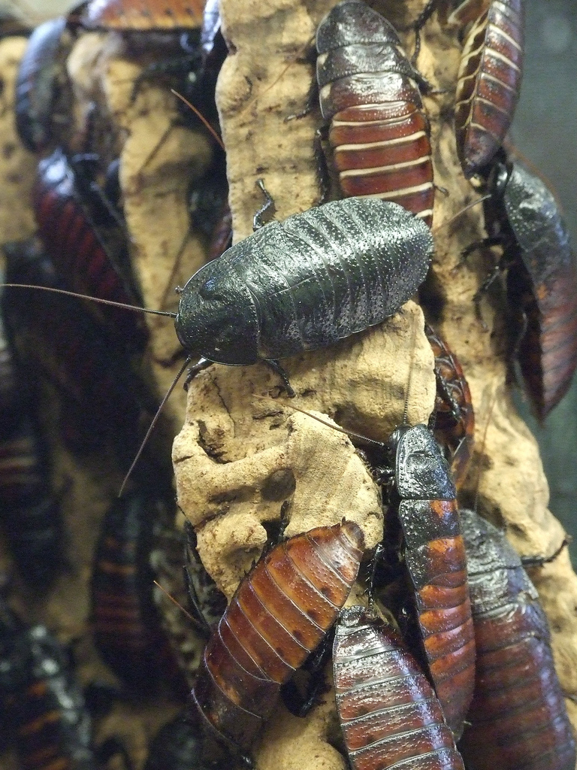
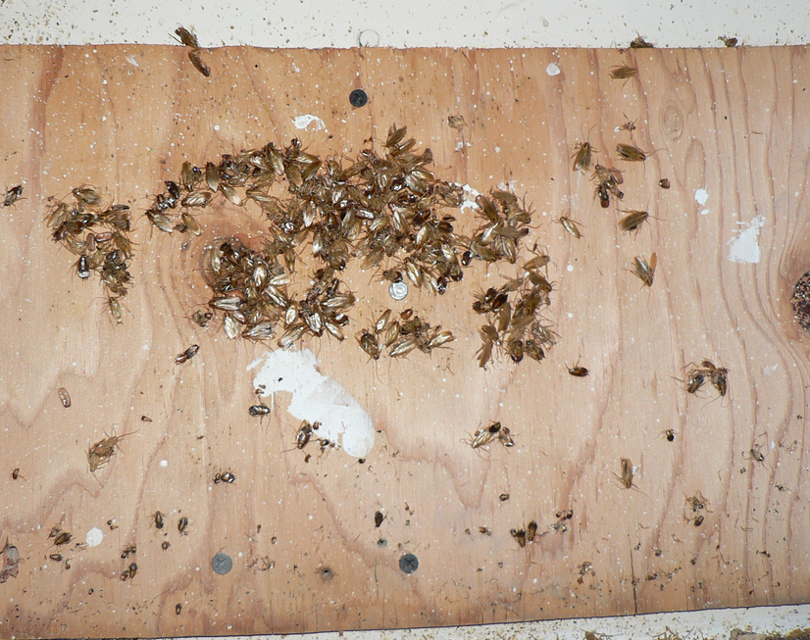
After “7” days, so the base is multiplied 7 times
How many cockroaches
there was in the beginning
The population “DOUBLES”
each day
© Copyright all rights reserved to Homework depot: www.BCMath.ca

Slide 11
Homework
Pp 55-57
# 7 -9, 13, 15, 17, 18
© Copyright all rights reserved to Homework depot: www.BCMath.ca

